Slide 1
GAME KAKURO
Created by :
M fauzan
M Hudya ramadhana
Ulfa mulyantika

Slide 2
PURPOSE
To make a game which need concentration and logic when compute a number inside the game.

Slide 3
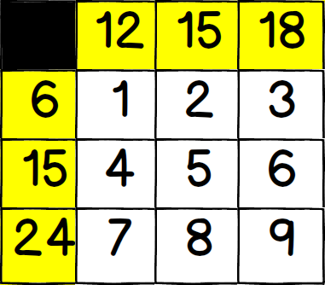
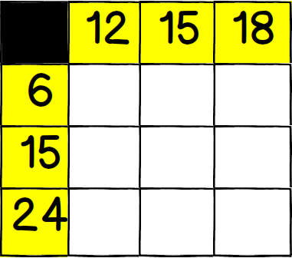
DESIGN GAME

Slide 4
System Analysis
System summary: Kakuro is a type of number puzzle in which players have to insert numbers into a number-like grid, with numbered clues and some blank squares
System processes: First, player chose start. then, the player input the number into blank squares and in Each line, the number not same horizontal or vertical. The player must sum each line vertical or horizontal and must same with the numbered clues.

Slide 5
FLOWCHART
Procedure buatpapan

Slide 6
PROCEDURE CALL BERMAIN

Slide 7
PROCEDURE CEKPAPAN

Slide 8
PROCEDURE CEK KEMENANGAN

Slide 9
PROCEDURE CEK KUNCI

Slide 10
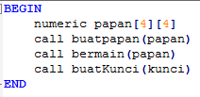
PSEUDOCODE
Main Program

Slide 11
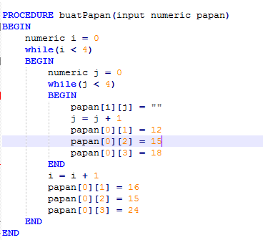
PROCEDURE BUAT PAPAN

Slide 12
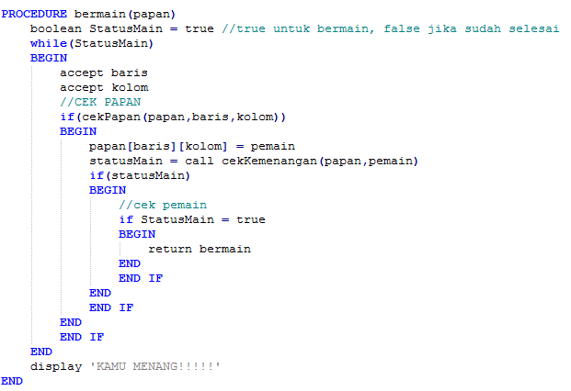
PROCEDURE BERMAIN

Slide 13
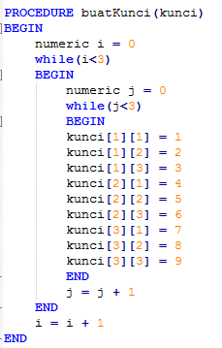
PROCEDURE BUAT KUNCI

Slide 14
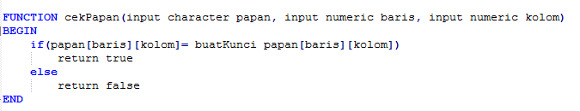
FUNCTION CEK PAPAN

Slide 15
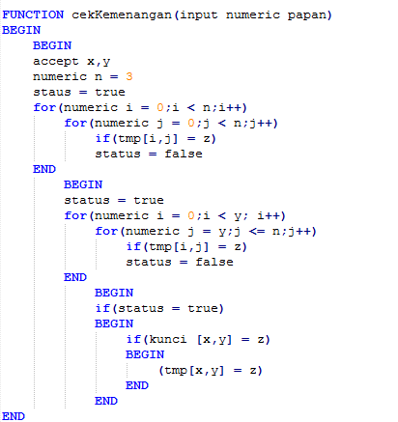
FUNCTION CEK KEMENANGAN

Slide 16
DRY RUN NUMBER INPUT
Input Number | Output
1 | 1
2 | 2
3 | 3
4 | 4
5 | 5
6 | 6
7 | 7
8 | 8
9 | 9
4 | Invalid, No repition number

Slide 17
DRY RUN SUM NUMBER
Number Column or row = Sum | Sum/Output
1+4+7 | 12
4+2+3 | Invalid, Unmatched with key answer

Slide 18
THANKS FOR YOUR ATTENTION

